Slide 1

Welcome!
Today’s Agenda
Introductions
Administrative notes
Syllabus review
General notes on participation

Slide 2
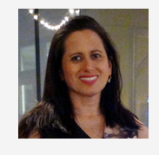
Introduction
Dr. Dee Chiluiza, PhD
Instructor
College of Professional Studies
Northeastern University

Slide 3



WHERE I’VE STUDIED
Bachelor’s in Biological Sciences
Master in Sciences
PhD in Molecular Biology

Slide 4





WHERE I’VE WORKED
Biotech Company
Ecuadorian Government
Secretary of Science and Education

Slide 5






WHERE I’VE LIVED
Ecuador
Mississippi

Slide 6
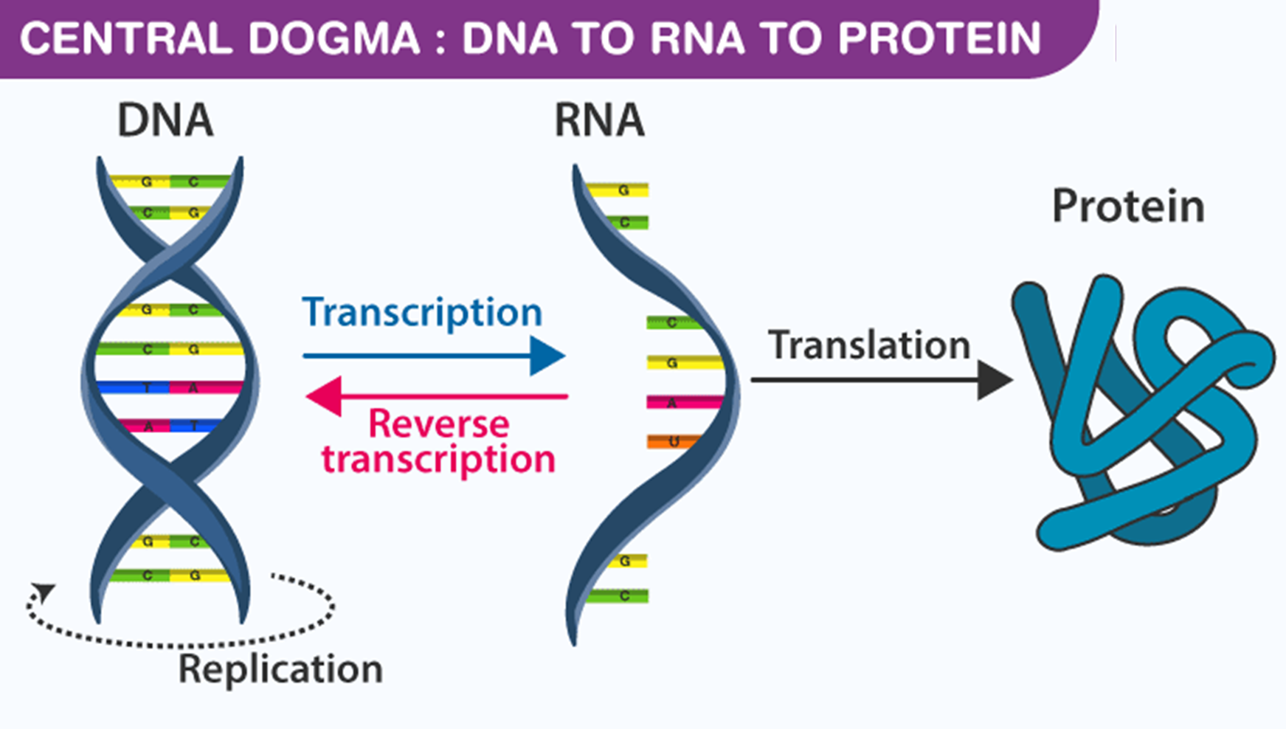
What I do and how is it related to data analytics and statistics

Slide 7
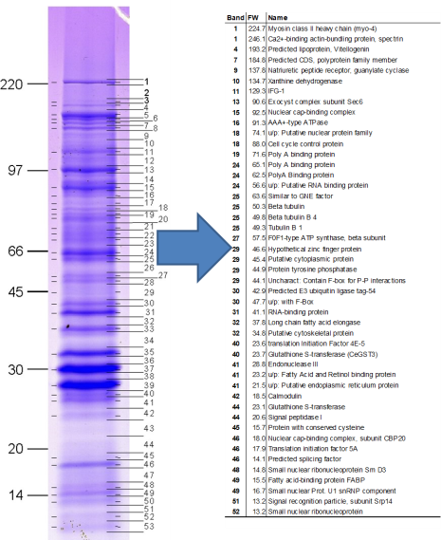
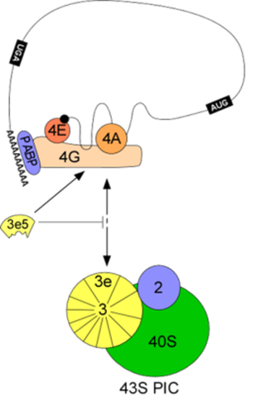
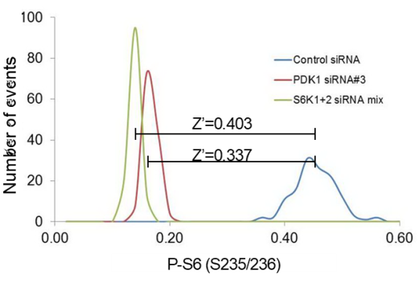
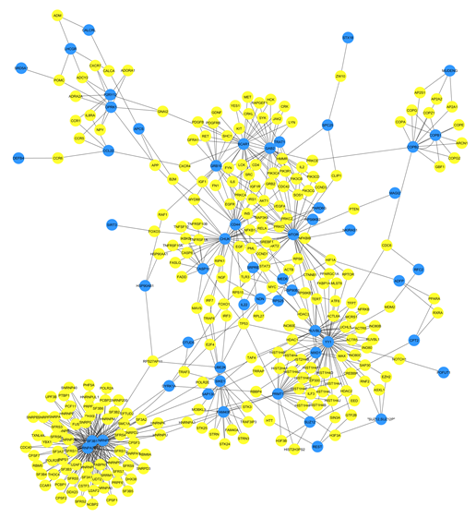
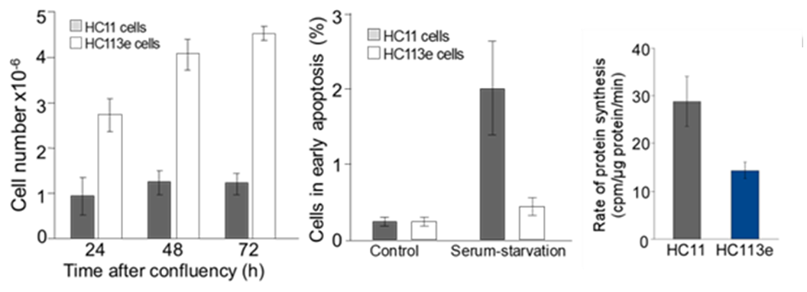

Slide 8
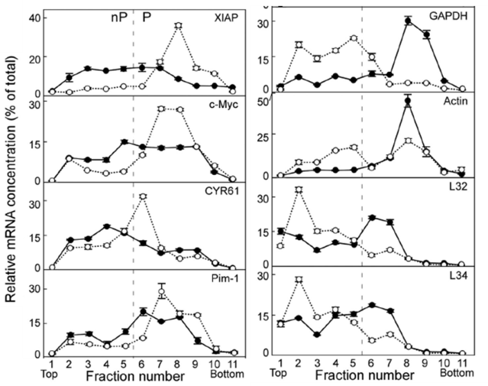

Slide 9
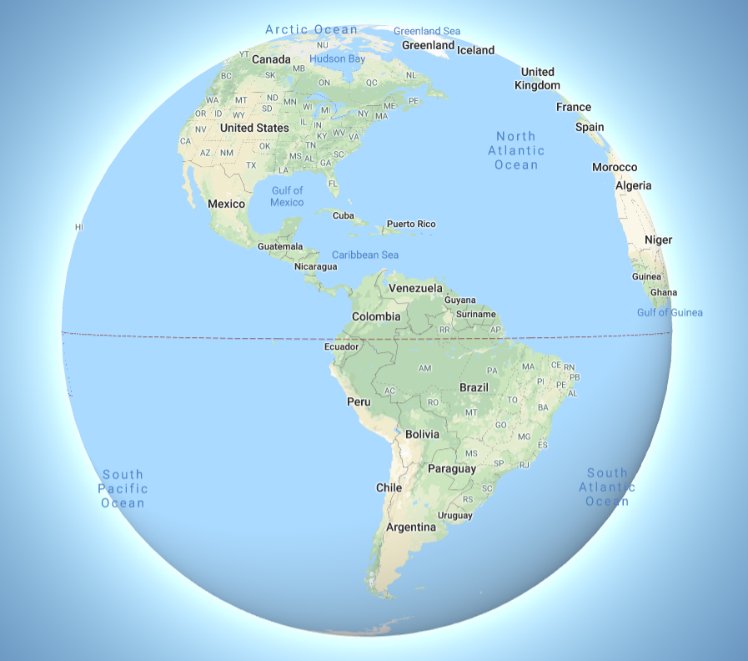
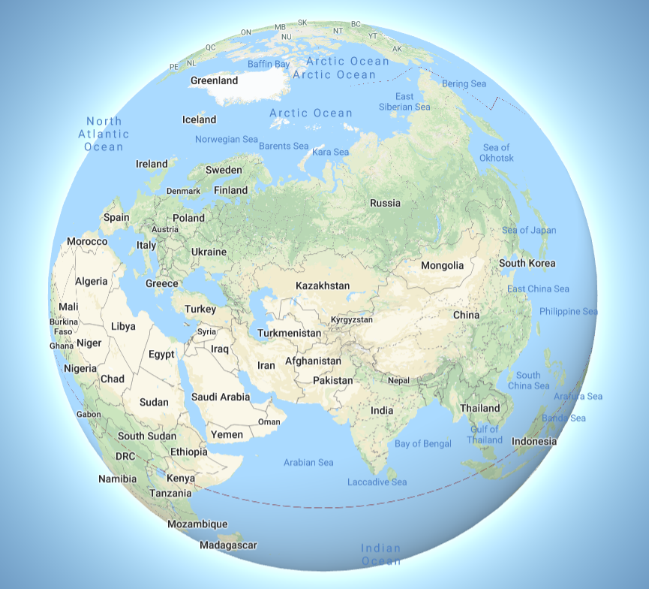
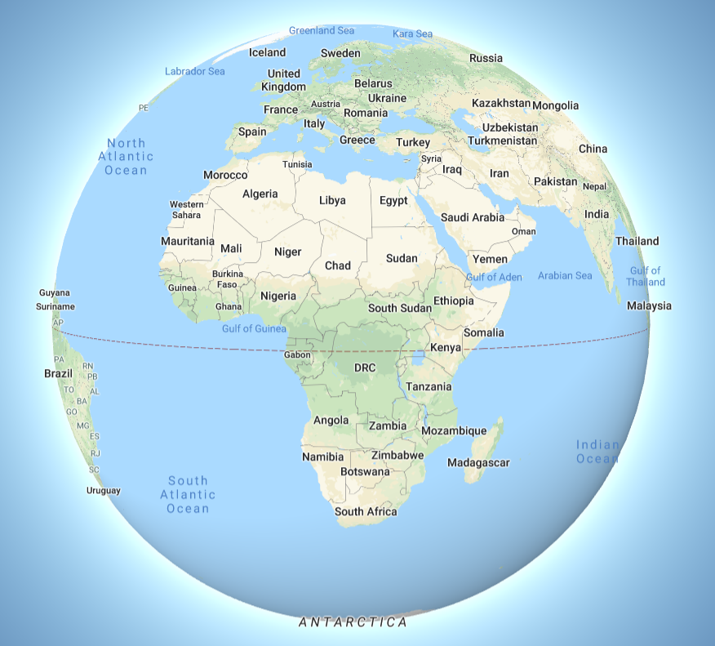
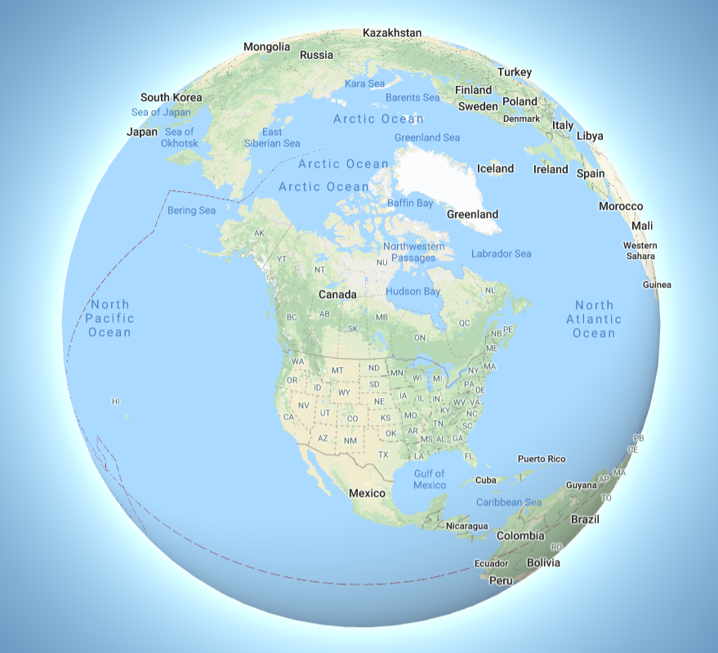
Your turn!
Please introduce yourself!

Slide 10
Administrative Notes
We will conduct live practice sessions with Excel and R.
Classroom participation is crucial for learning
Refer to syllabus for grading and assignment dates
Check current syllabus, there might be some minor changes, specially to dates of assignments during the semester
I will publish an announcement if changes happen

Slide 11


Syllabus review: Books
Elementary Statistics,
A Step by Step Approach. 10th Edition.
Allan G. Bluman,
McGraw Hill Publishing
R in Action 2nd Edition.
Robert Kabacoff
Manning Publishing
Book:
https://learning.oreilly.com/library/view/r-in-action/9781617291388/
Video edition:
https://learning.oreilly.com/videos/r-in-action/9781617291388VE

Slide 12




Syllabus Review: Software
R and Microsoft Excel – the most commonly used Business Intelligence tools
Datasets are geared towards Excel
Word and Power Point

Slide 13

Syllabus review: Online training Resources
Statistics and R
https://www.youtube.com/user/marinstatlectures/playlists
Statistics Foundations 1
https://www.linkedin.com/learning/statistics-foundations-1/welcome?u=74653650
R for beginners
https://education.rstudio.com/learn/beginner/
R statistics Essential Training
https://www.linkedin.com/learning/r-statistics-essential-training/installing-and-managing-packages?u=74653650

Slide 14
Recommended Reading Activities
The following activities are not graded but are highly recommended in order to ensure your best experience in the class. There will be a question-answer activity on these topics during the first two weeks. Please observe the following links, also please find and read other sources of information, I will ask about these topics in our first class.
1. Critical Thinking
Link: https://www.lynda.com/Business-Skills-tutorials/Welcome-critical-thinking/424116/500483-4.html?org=neu.edu
2. A brief view to problem solving skills
Link: https://www.skillsyouneed.com/ips/problem-solving.html
3. Effective ways of using quotations:
Link: https://writingcenter.unc.edu/tips-and-tools/quotations
4. Tips on how to effectively present your data:
Link 1: https://youtu.be/TtRWoLEvcKE
Link 2: https://youtu.be/HvgwXn7EEz4
5. How to avoid unwanted plagiarism:
Link: https://library.northeastern.edu/get-help/research-tutorials/avoid-plagiarism
6. Proper ways to apply APA style for reports:
Link 1: Using American Psychological Association (APA) style, Lynda.com
Link 2: https://youtu.be/_ODakMMqvIs

Slide 15
Syllabus Review:
Weekly responsibilities
Read each week Learning Material
Attend classes Tuesdays from 8:00 am to 10:30 am
Join Zoom Meeting using link in CANVAS
Actively participate during class
Complete Quizzes, due on Saturdays at 11:59 pm
Submit Discussion Board assignment
Primary response due on Fridays at 11:59 pm
Replies to classmates due on Saturdays at 11:59 pm
Submit Project assignment, due on Saturdays at 11:59 pm

Slide 16
Project Submissions
Project submissions will consist of:
- An R file containing all your calculations
- A Report in Word or PDF format written using APA standard.
- On Module 1 only, report is presented in a Power Point file.
Late policy:
- Late submissions will receive 20% grade reduction
- No submissions are accepted 7 days after due date
- Medical emergencies need to be accompanied with documented proof
Groups:
- Some projects can be developed as teams, your Instructor will indicate which ones.

Slide 17

Academic Integrity
It is not “just” policing your work, it ensures you will be able to perform independently what the course purports to teach!
In case of doubt, any doubt at all, I immediately refer to the office of conduct.
This referral is not a “punishment”, it is a referral to authorities who are specialized in assessing and educating you in the appropriate standards of work.
Stay in contact with you Faculty Advisor, ask them how to avoid potential unwanted faults to academic integrity.
Take the Academic Integrity Quiz immediately

Slide 18
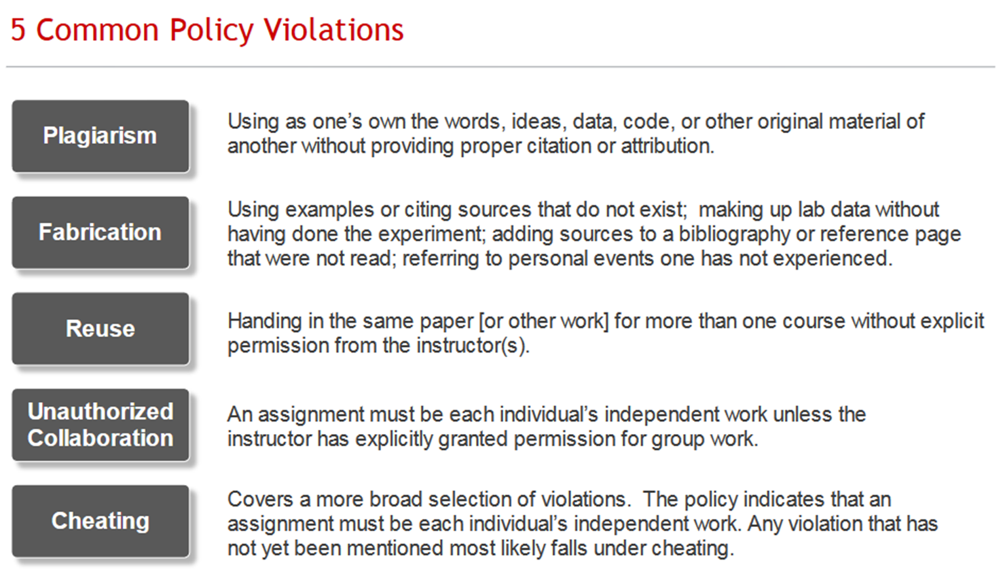
https://cps.northeastern.edu/academic-resources/academic-integrity

Slide 20
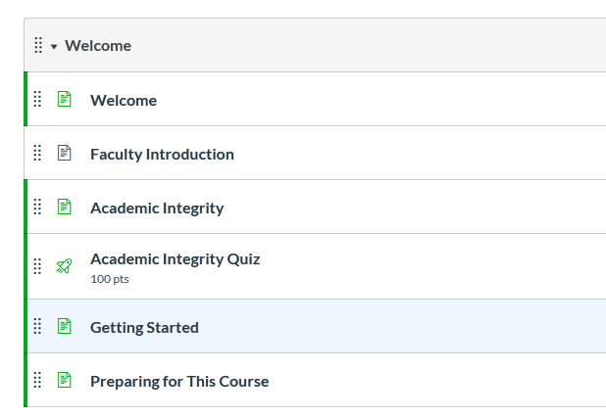

Slide 21
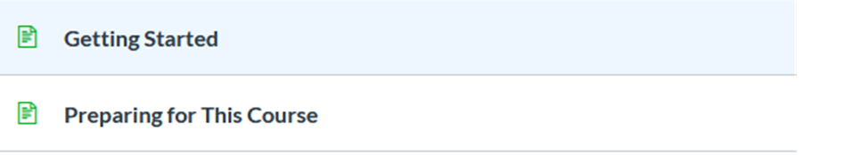
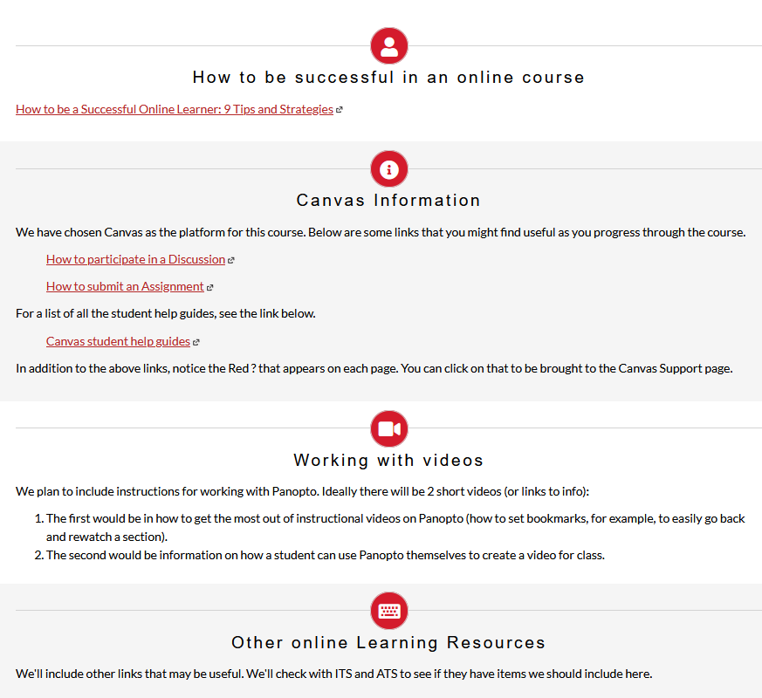

Slide 22
The following are required materials for this course:
KABACOFF R Scripts for Textbok: RiA2_SourceCode.zip
BLUMAN Textbook Problem Solutions: TextbookSolutions-1.zip
BLUMAN eBook: https://create.mheducation.com/shop/#/catalog/details/?isbn=9781307629361 (Links to an external site.)
Bluman Elementary Statistics: A Step by Step Approach 10th edition, McGraw Hill ISBN 978-1-260-04200-9 (I’m pretty sure this ISBN is not correct)
R. Kabacoff, R in Action 2nd edition, Manning, ISBN 978-1-617-29138-8
RStudio (free download - https://rstudio.com/products/rstudio/download/ (Links to an external site.)) - Be sure to download Version 3.6.3 of R.

Slide 23
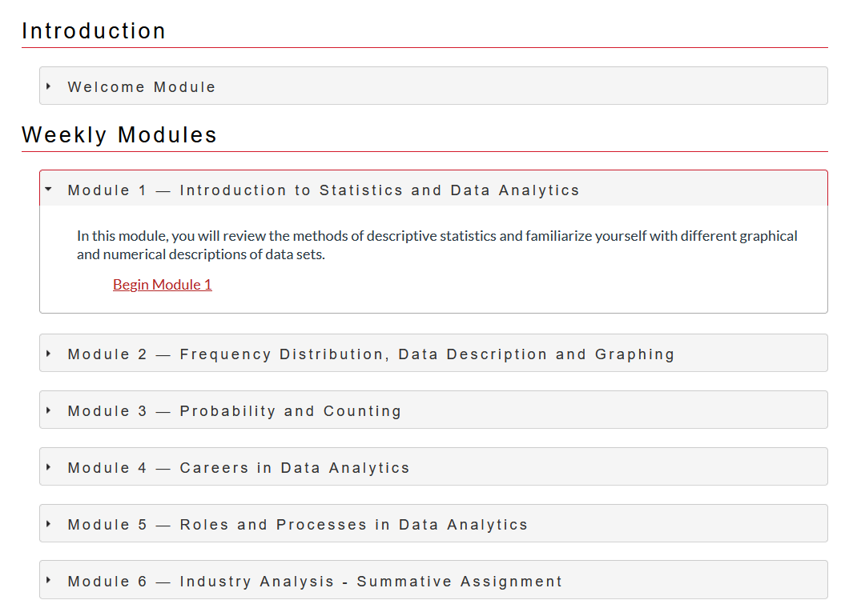
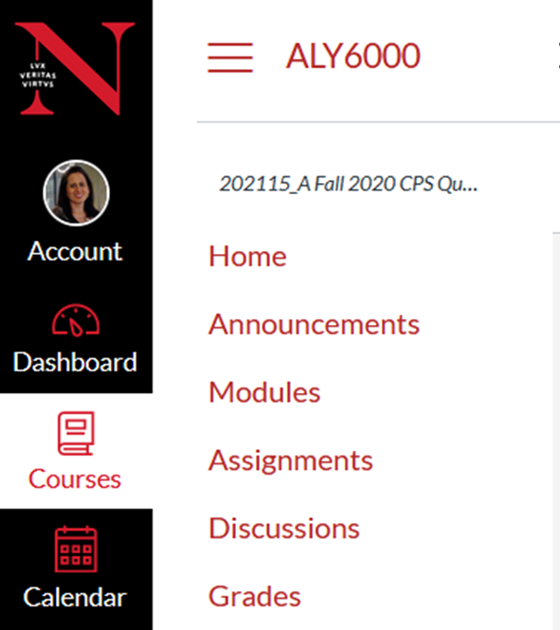
There are two ways to access our course modules in Canvas
Through Home you will get general information about each module.

Slide 24
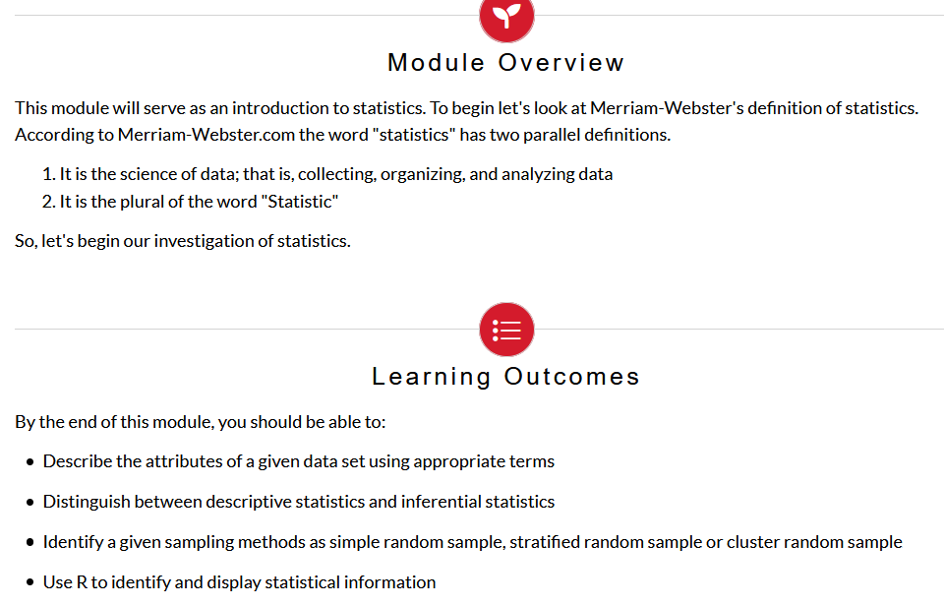
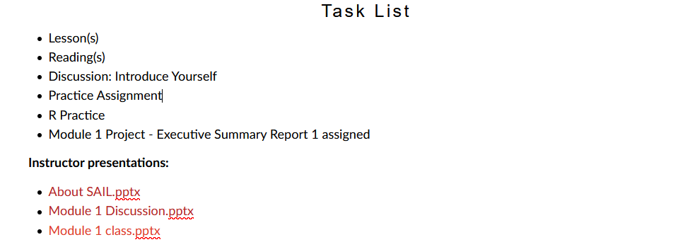

Slide 25
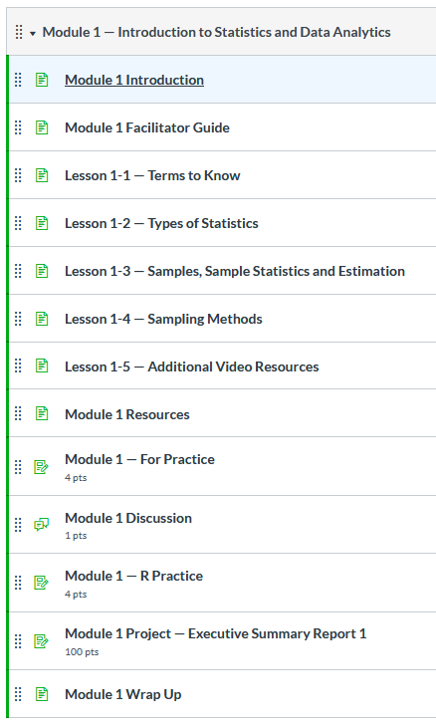
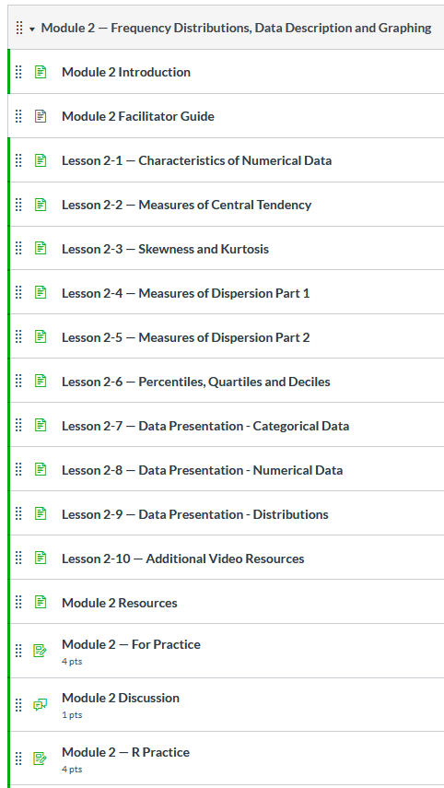
Through Modules you will get all the information about each module.

Slide 26
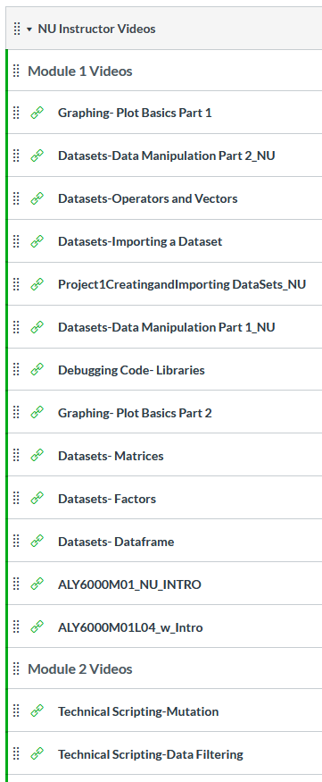

Slide 27
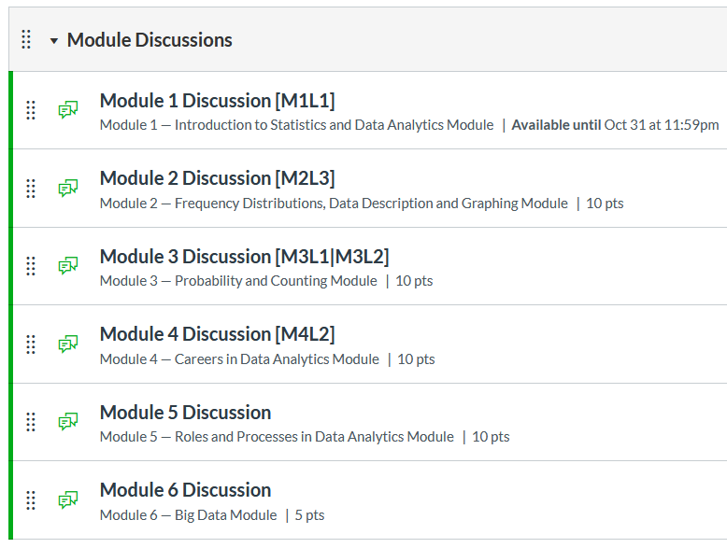
Graded

Slide 28
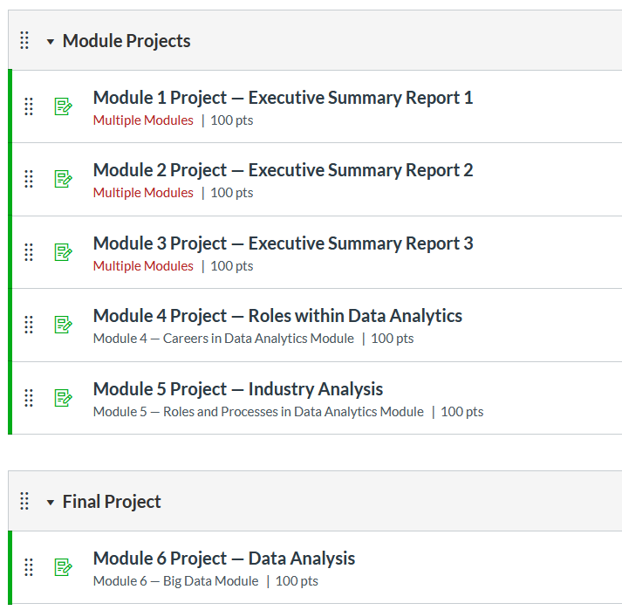
Graded

Slide 29
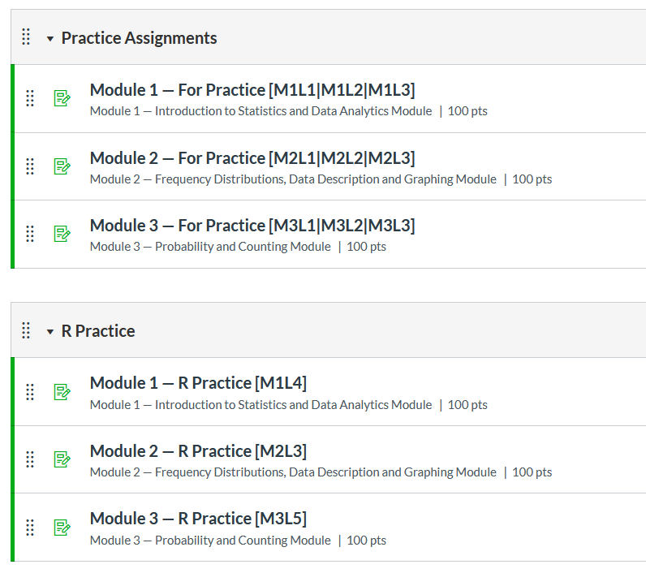
Not Graded

Slide 30
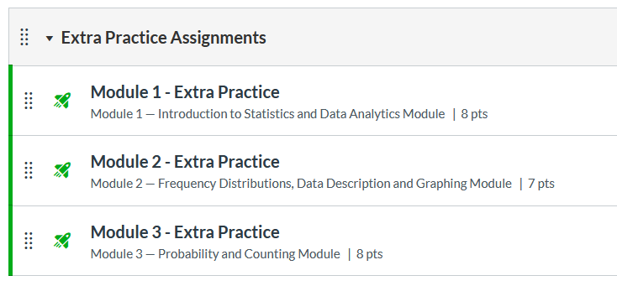
Not Graded

Slide 31
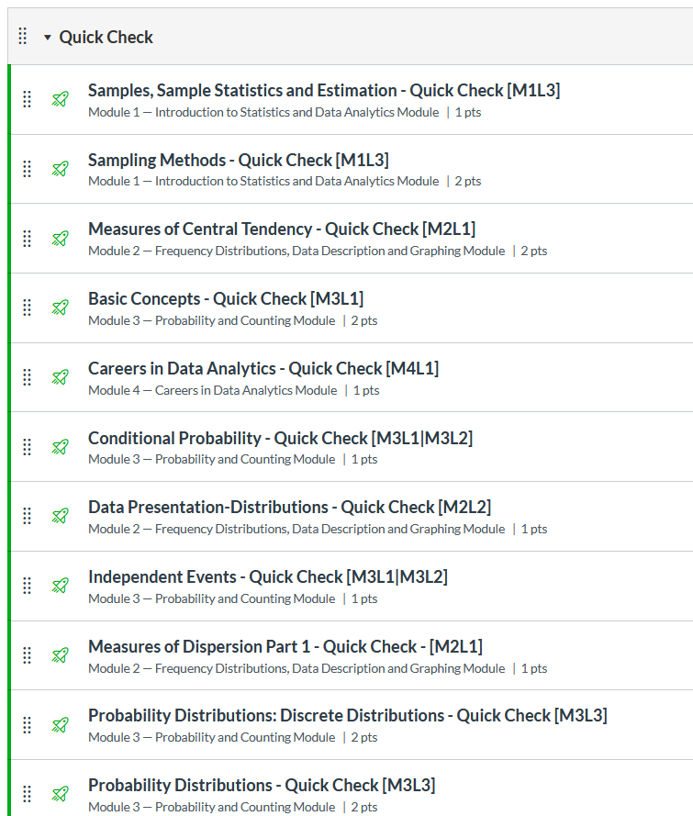
Not Graded

Slide 32
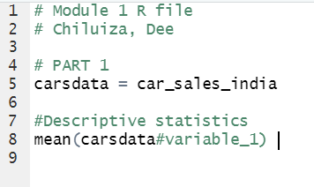
Organize your R codes

